Slide 1
Azure Weekend 2020

Slide 2
Azure Machine Learning for Data Science
Eng Teong Cheah
Microsoft MVP

Slide 3
Getting Started with Azure Machine Learning

Slide 4











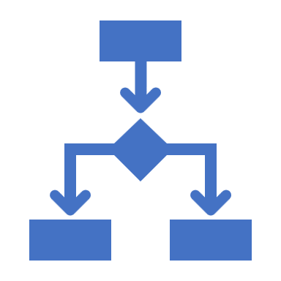



What is Azure Machine Learning?
A platform for operating machine learning workloads in the cloud
Azure Machine Learning
Scalable, on-demand compute
Data storage and connectivity
ML workflow orchestration
Model registration and management
Metrics and monitoring
Model deployment
Microsoft Azure

Slide 5









Azure Machine Learning Workspaces
Microsoft Azure
Subscription
Resource Group
Workspace
Storage Account
Application Insights
Key Vault
Virtual Machines
Container Registry
Compute
Notebooks
Pipelines
Data
Experiments
Models

Slide 6



Considerations for Creating a Workspace
Region
Edition
Check Azure Resource availability
For example, NC-Series Virtual Machines for GPU processing
Enterprise
All features
Basic
No Visual Designer
No Automated ML user interface
No Data Drift user interface

Slide 7
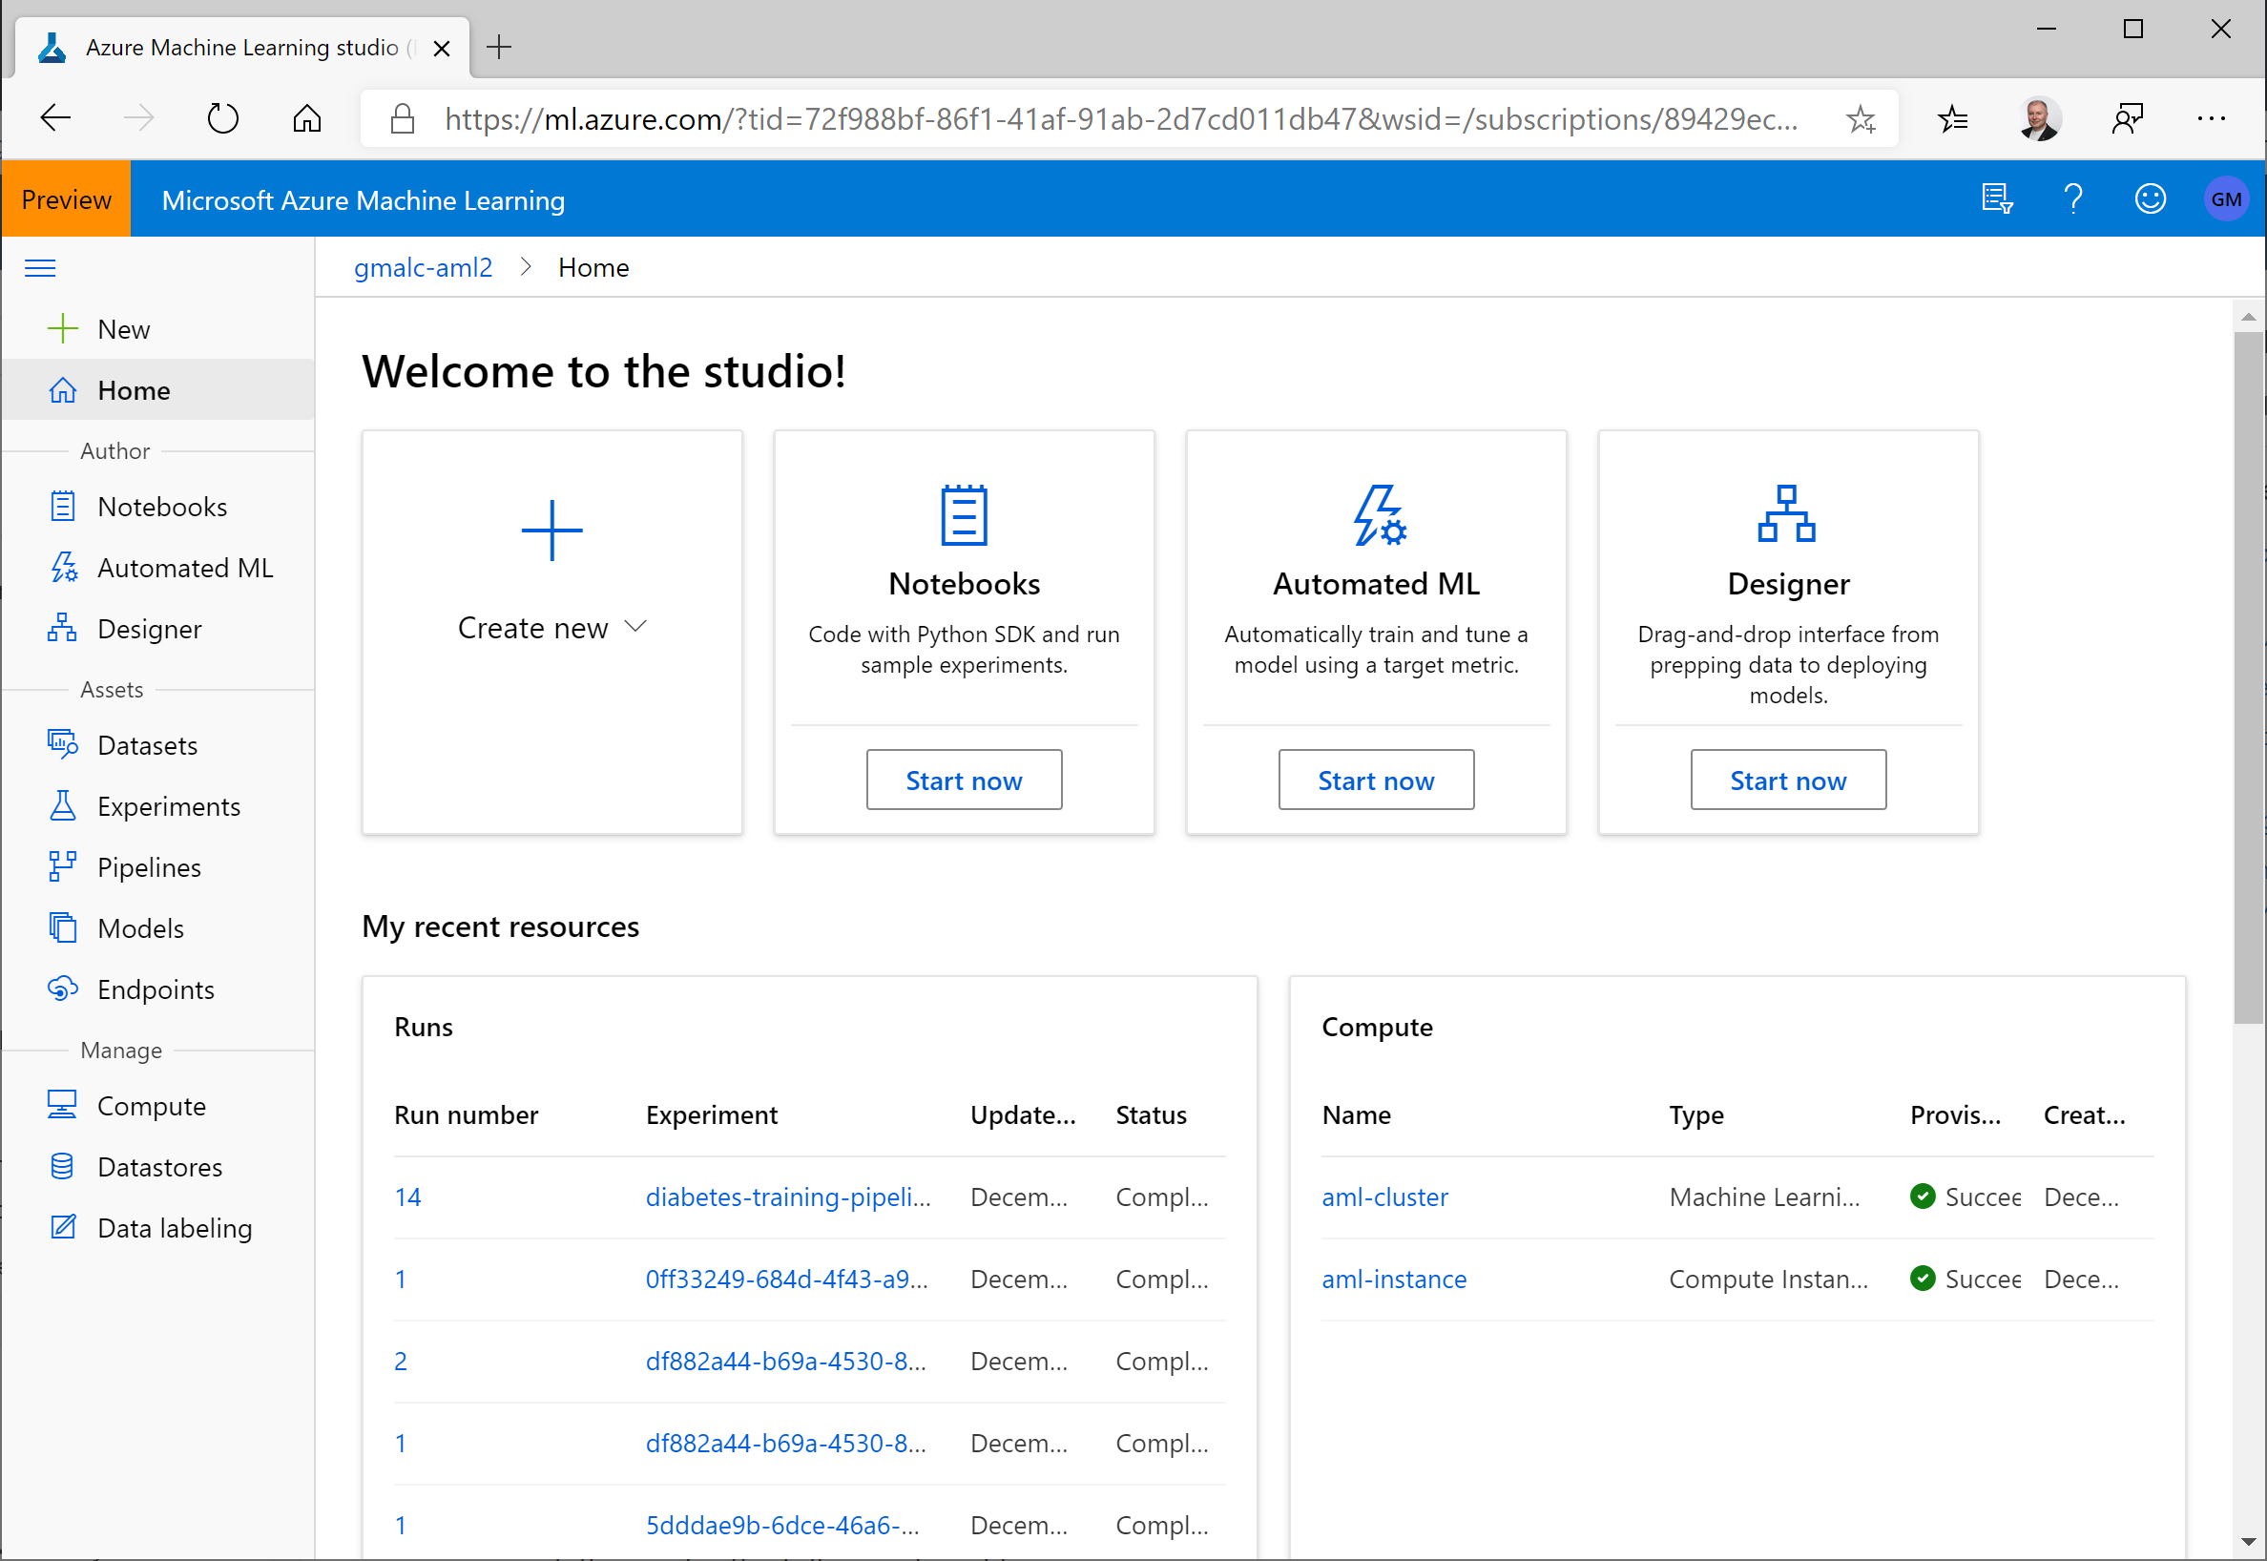
Azure Machine Learning studio
Manage compute and data
Run experiments
View metrics
Manage and deploy models
Manage endpoints
Use graphical modeling tools:
Designer - "no-code" model development
Automated Machine Learning - find the best model for your data

Slide 8
Demo
Creating an Azure Machine Learning Workspace

Slide 9
Azure Machine Learning Tools

Slide 10
The Azure Machine Learning SDK for Python
Code-based configuration for machine learning assets:
Automate repeatable asset creation
Ensure consistency across development, test, and production environments
Incorporate machine learning asset configuration into DevOps
pip install azureml-sdk
from azureml.core import Workspace
ws = Workspace.from_config()
for compute_name in ws.compute_targets:
compute = ws.compute_targets[compute_name]
print(compute.name, ":", compute.type)

Slide 11
Azure Machine Learning CLI Extension
Azure Machine Learning commands for the Azure CLI
Cross-platform command-line management of Azure Machine Learning assets
az extension add -n azure-cli-ml
az ml computetarget list -g 'aml-resources' -w 'aml-workspace'

Slide 12
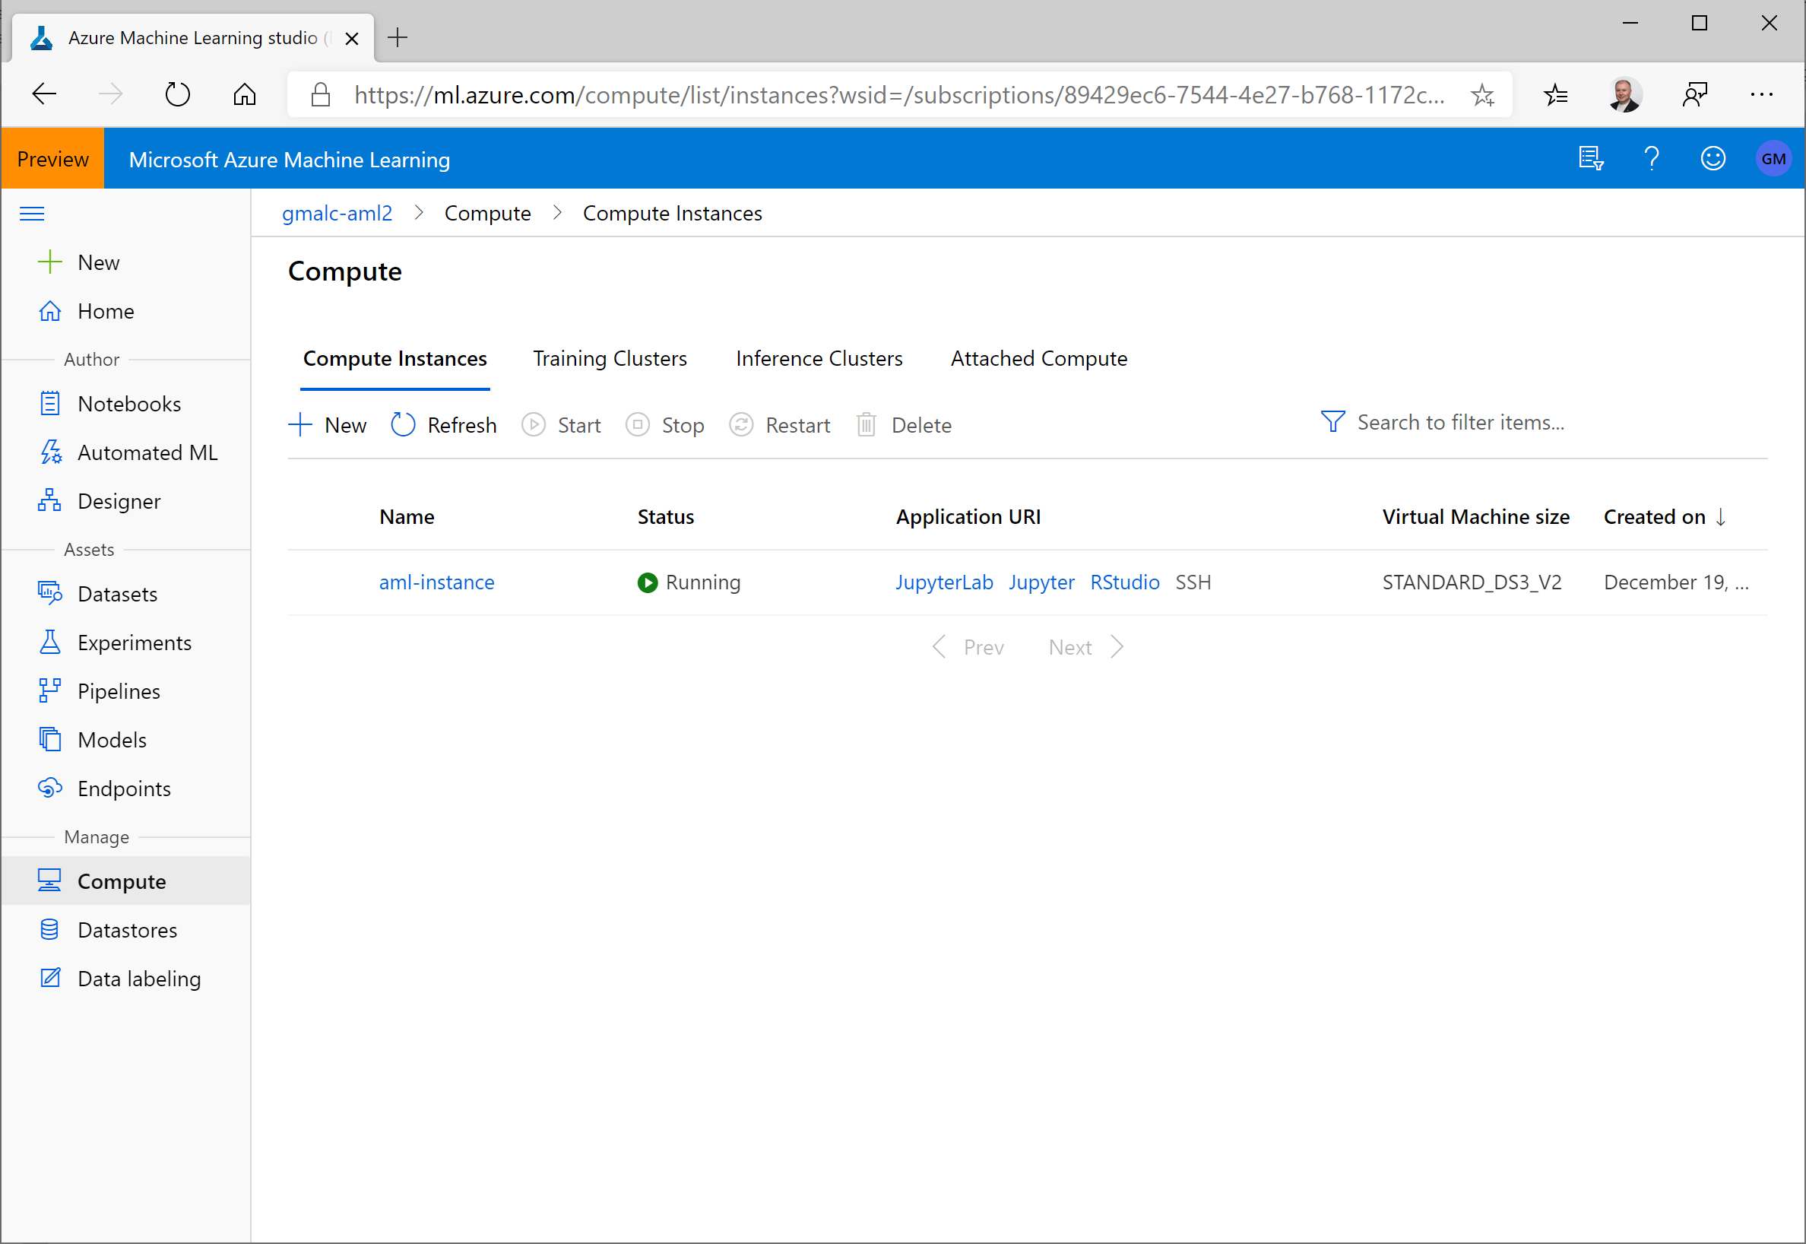
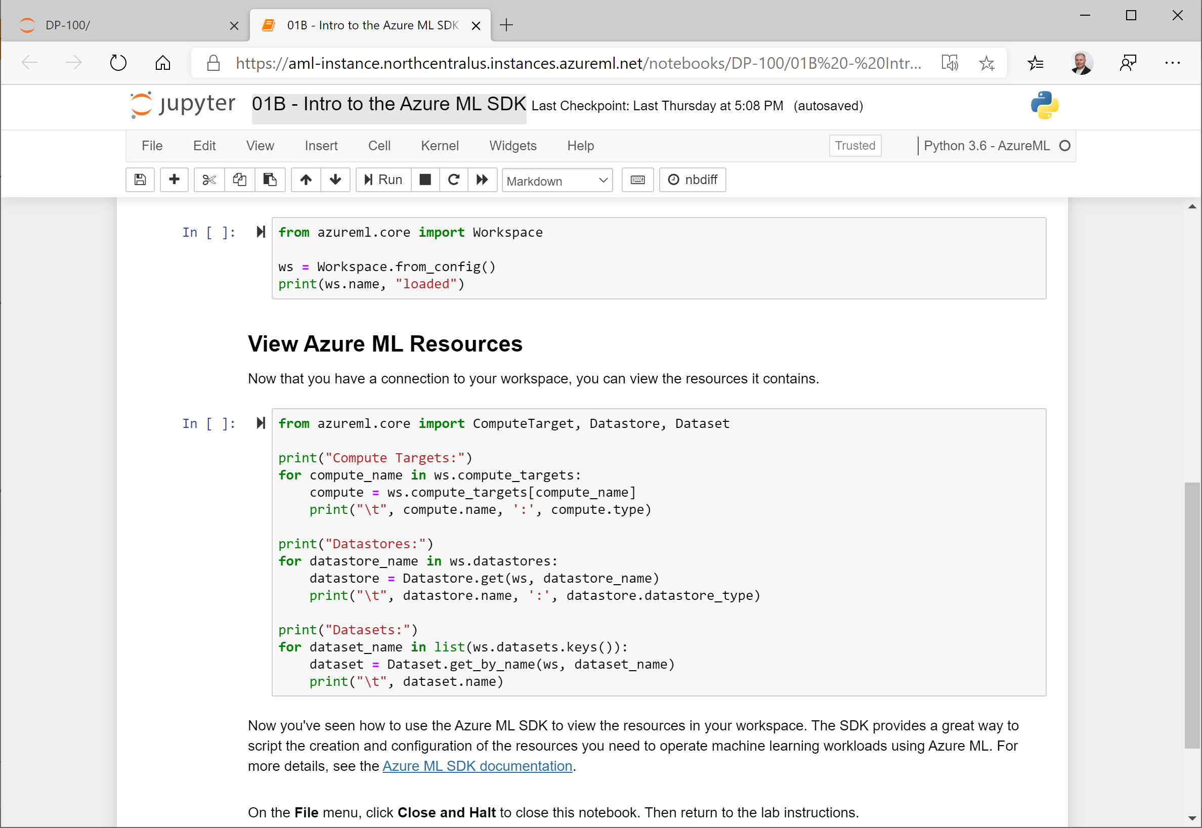
Compute Instances
Jupyter Notebook and JupyterLab servers in your workspace
Choose the compute specifications you need

Slide 13
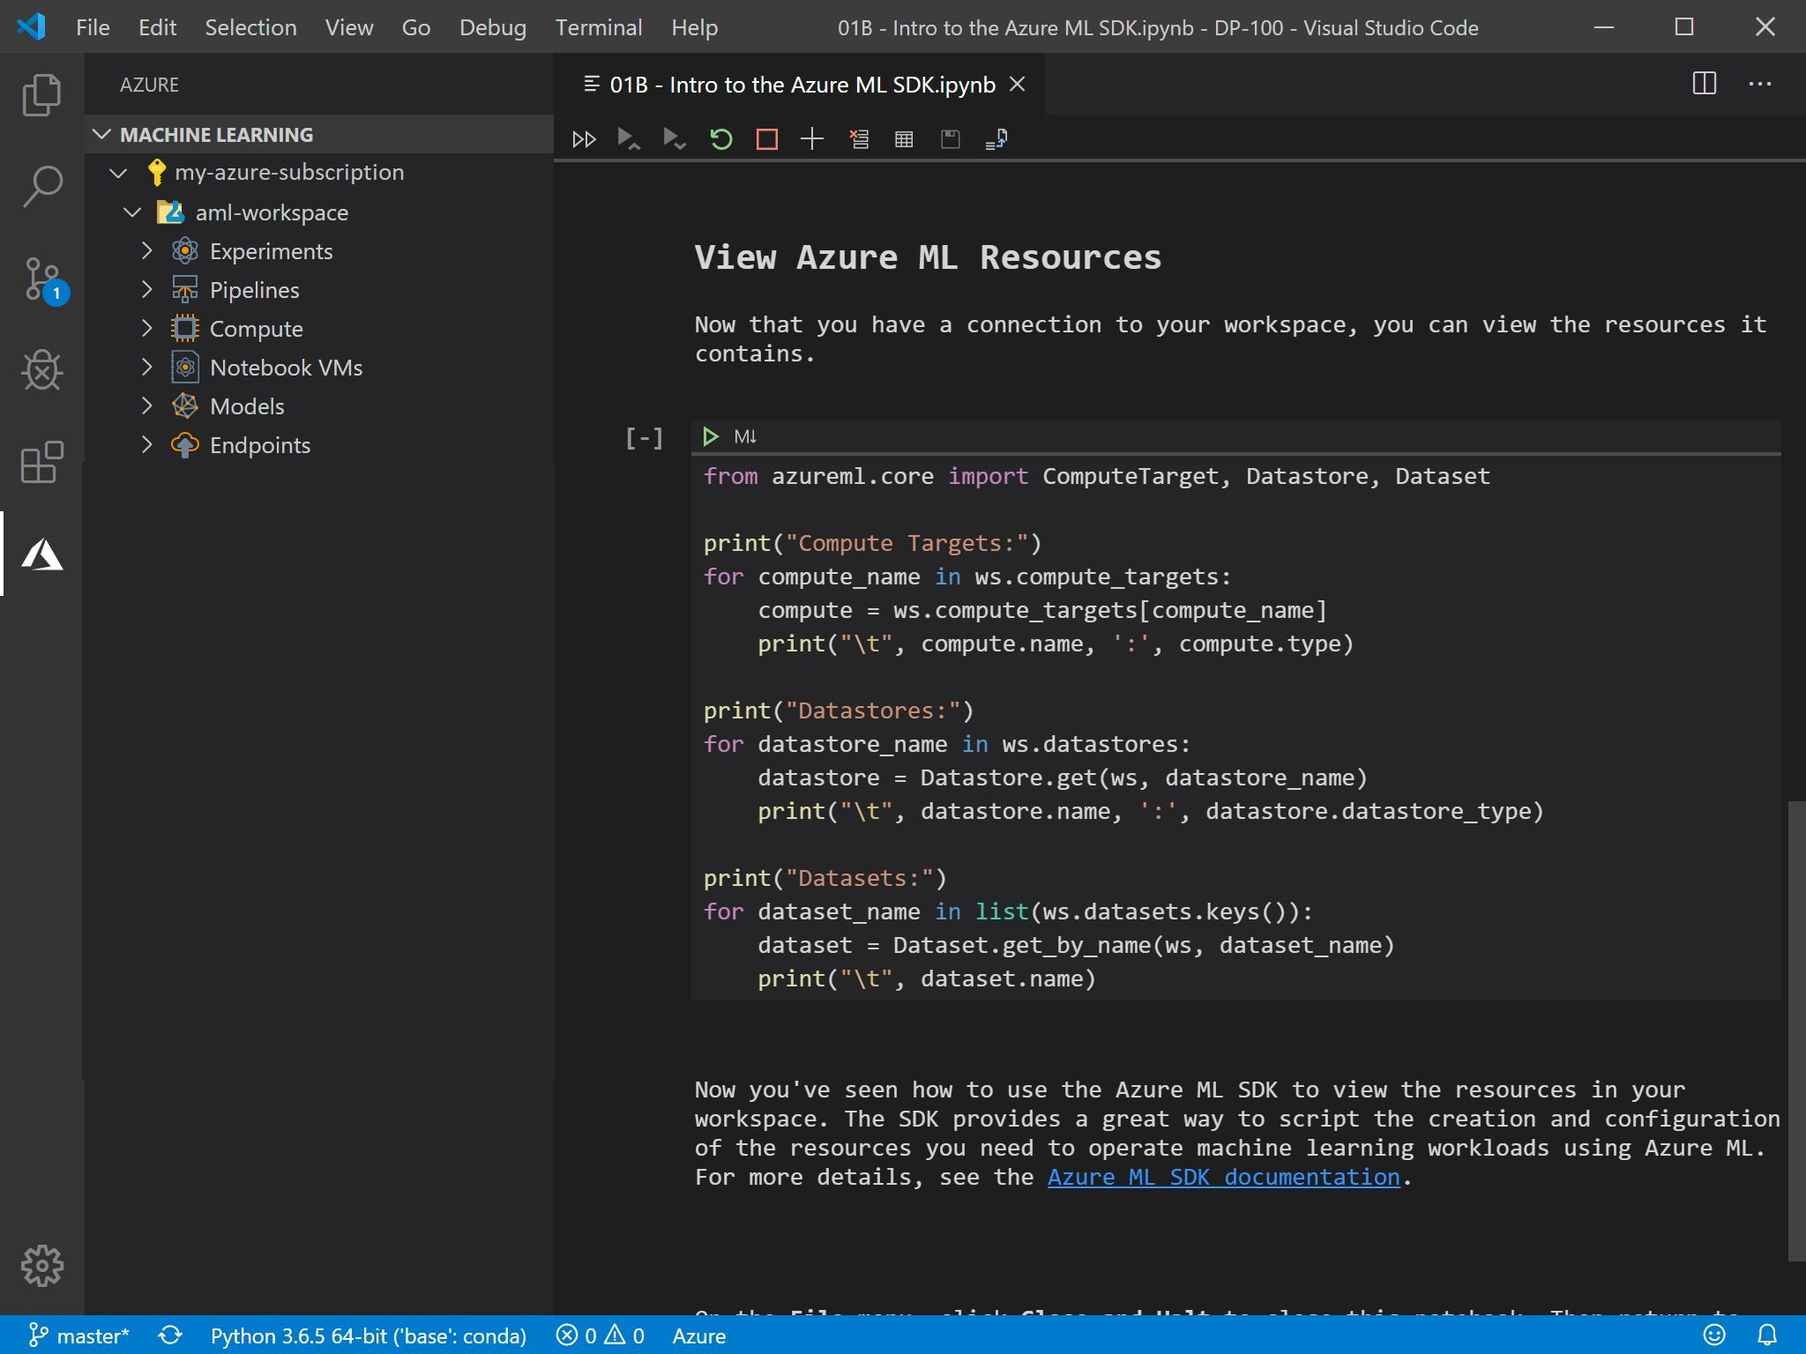
The Azure Machine Learning Extension for VS Code
Graphical Interface for working with Azure Machine Learning
When combined with the Python extension, a complete development environment for Azure Machine Learning

Slide 14
Demo
Working with Azure Machine Learning Tools

Slide 15
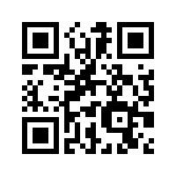
Thank You
Feedback URL: http://bit.ly/azwefeedback

Slide 17
Sample Code

